Slide 1
Data Wizards Project #1
By Di Chen, Mai Castellano, Spencer Hutchison & Tyler Kussee
Notes:
Tyler

Slide 2
Explanation Of The Data
This data comes from The American Community Survey.
Individuals are surveyed on an annual basis to gain information on the citizens across the United States.
This dataset is centered around those individuals above the age of 14 and who lived in Oregon in the year 2022.
The variables we worked with were age, education level, income, sex, race, home ownership, occupation, marital status and house acreage.
Notes:
Tyler

Slide 3
Questions of Interest
Does higher education mean higher income accounting for sex and age?
Can we predict the household income based on education, occupation, and race/ethnicity?
Is there a relationship between Occupation, home ownership, race/ethnicity and Marital Status, occupation group, and income?
Notes:
Tyler

Slide 4
Question 1: Does higher education mean higher income accounting for sex and age?
Variables: Income as the response variable, Groupings of the education levels, Sex and age interactions.
We considered two models after fixing model issues:
Using the level of education groups, sex and age as explanatory variables.
Extended the first by incorporating interactions between sex and age.
Employing Ridge regression and 10-fold cross-validation our optimal regression model was:
log(Income) = 9.436 + 0.379(HS, GED, orAssociatesDegree)+
1(BachelorsDegree) + 1.323(M astersDegreeorhigher)+
0.232(Male) + 0.002(Age) + 0.003(Male : Age)
Notes:
Cindy

Slide 5
Question 1: Interpretation
For 50-year-old males in Oregon, educational attainment significantly affects median income. Less than high school: $21,273.80. High school, GED, or associate degree: $31,089.90. Bachelor’s degree: $57,829.09. Master’s degree or higher: $79,867.54.
Similarly, for females: less than high school: $14,136.47. High school, GED, or associate degree: $20,659.28. Bachelor’s degree: $38,427.51. Master’s degree or higher: $53,072.1.
These results show a clear positive correlation between education and income for both genders, with significant increases seen at bachelor’s degree level and above.
Notes:
Cindy

Slide 6
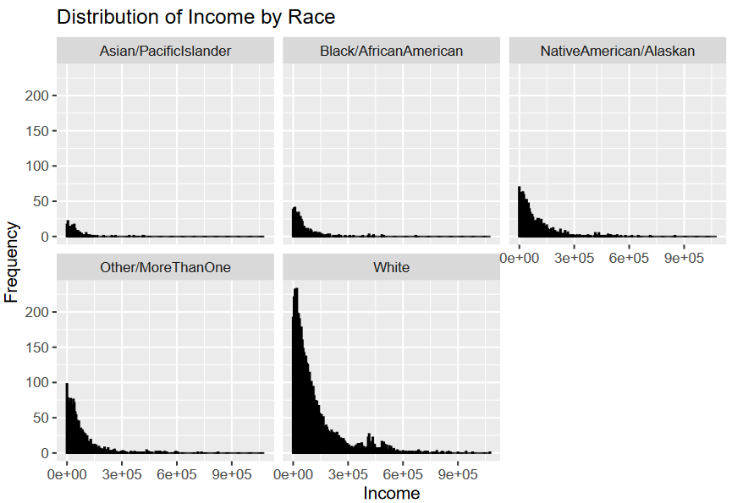
Question 2: Can we predict the household income based on education, occupation, and race/ethnicity?
Visual insight into Income vs. Race/Ethnicity.
Best subset selection with a test set method and then subsequently using the entirety of the dataset we settled on an 11-variable model, which gave the least mean square error.
Notes:
Mai

Slide 7
Question 2: Interpretation
Our current findings suggest that Education, Race, and OccupationGroup are significant predictors for household income.
These findings shed light on the key factors influencing income levels and could guide future research and policy efforts aimed at reducing income disparities.
Notes:
Mai

Slide 8
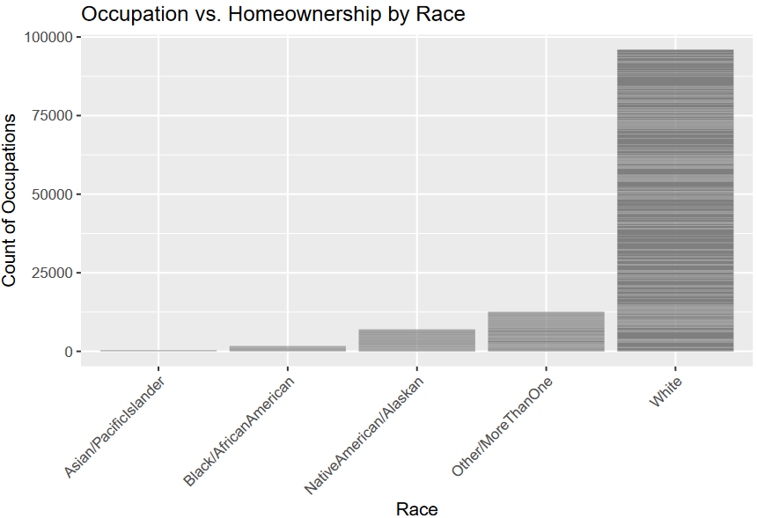
Question 3: Is there a relationship between Occupation, home ownership, race/ethnicity and Marial Status, OccupationGroup, income?
We start by utilizing the model that we discovered in our research of question 1.
We went through many different explanatory variables to determine the best model to explain occupation.
Notes:
Spencer

Slide 9
Question 3: Interpretation
We compared many different models with different explanatory variables starting with the base model from question 1.
We were looking for the model that produced the best residual sum of squares for predictive power.
We also considered an interaction term-focused model between marital status and occupation group, which provides additional value to predicting occupation.
Notes:
Spencer

Slide 10
Obstacles & Solutions
Git Collaboration
Working on the main branch led to overwriting.
Personal branches led to code merge issues.
Eventually resolved through experience.
Notes:
Mai

Slide 11
Future Work/Improvements
Categorical Variables are overwhelming
Slowed down our R code processing.
Clean up the questions we’re looking at.
As few categorical variables as possible.
Notes:
Cindy

Slide 12
Conclusion
Strong positive correlation between education attainment and income for both males & females.
Education, race and occupations are significant predictors of household incomes.
Valuable insight into how these variables interact and influence occupation and incomes.
Notes:
Tyler

